Slide 1
Domain Modeling
Chandan R. Rupakheti and Steve Chenoweth
Week 5, Day 1
Notes:
Reading – we’ll ask a couple quiz questions also from the Pace University tutorial at http://csis.pace.edu/~marchese/CS389/L8/DomainModel-UML_short.pdf.
Help in here for most of the quiz questions – see pages marked Q1, etc.

Slide 2
Today
Domain Modeling
Notations
Guidelines
Practice

Slide 3
Domain Model
The domain model is a representation of real-situation conceptual classes
The term does not mean a set of diagram describing software classes
Bridges the representational gap between Use-Case Model and Software Design Model (such as Class and Interaction Diagrams)
Q1
Notes:
Q1 = help for Quiz Question 1, etc.
Why do a domain model? This page gives the main answers (top and bottom bullets.) For even more, see the additional resource – page 5 of the pdf.

Slide 4
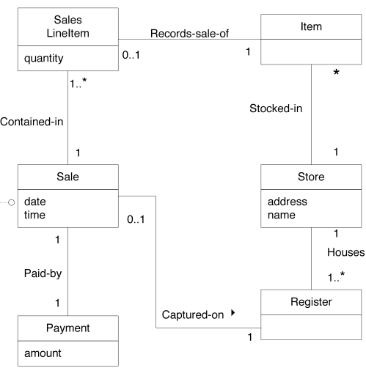
An Example – POS System
Notes:
POS: Point of Sale System
A POS system is a computerized application used in part to record sales and handle payments; it is typically used in a retail store. It includes hardware components such as computer and bar code scanner, and software to run the system. It interfaces to various service applications, such as a third-party tax calculator and inventory control.
Sometime an arrow (e.g., “Captured-on →”) is used to help with reading. For instance, “Zero to one Sale is Captured-on a Register.” The arrow provides direction for reading the relation properly.

Slide 5
Notation – UML Class Diagram
UML class diagram is used to model a domain with a twist
Domain Class
  Domain class consist of class name and attributes
  Domain class does not have methods
Relation
  A line with a label represents the relation between two classes
  A relation has a cardinality constraint
Q2

Slide 6
How to Create Domain Model
Find conceptual classes
Draw them as classes in a UML class diagram
Add associations and attributes

Slide 7
Finding Conceptual Classes
Reuse or modify the existing model if one exists
Use a category list
Identify noun phrases in your use-cases

Slide 8
Category List (Partial)
Business transaction
  Sale, Payment, Reservation
Product or service related to transaction
  Item, Flight, Seat
Where is the transaction recorded
  Register, Ledger, FlightManifest
Place of service
  Store, Airport, Plane, Seat
Notes:
There are many others (ignored for brevity). The additional resource, p 9 of the pdf, introduces some of these other categories that often make good domain classes.
Find if there is such a category list for the domain you are working on.

Slide 9
Identify Noun Phrase in Use Cases
Basic Flow for a POS System
Customer arrives at a POS checkout with goods and/or services to purchase
Cashier start a new sale
Cashier enters item identifier
System records sale line item and presents item description, price, and running total
…

Slide 10
List and Draw UML Diagram
Sale
Cash Payment
SaleLineItem
Item
Register
Amount
Cashier
…
1. Decide which ones are classes and which ones are attributes
2. Add attributes and relation to the identified domain classes
Notes:
Note that there may be more domain classes than that are found in use cases (some may be just in the domain expert’s head). So, list down as many classes as you (the domain expert) can think of that are related to your project.
You will then have to make an educated decision based on the client’s requirement if you need to model all of those classes or not. Ignore classes that has nothing to do with requirements.
As you already noticed, this is an art rather than science and you are bound to be imprecise. But with iterations, you will refine them and make the model better.

Slide 11
Part of POS System

Slide 12
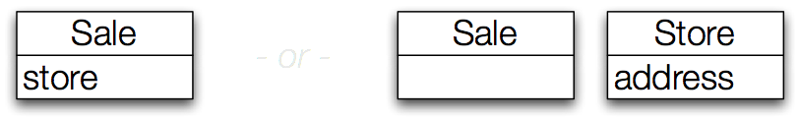
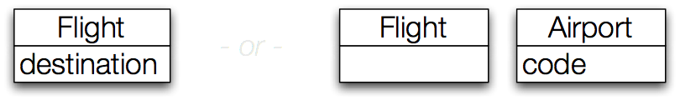
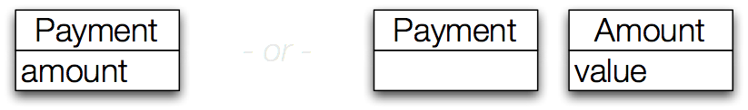
Attributes vs. Classes
- or -
- or -
- or -
Q3
Notes:
If we do not think of some conceptual class X as a number or text in the real world, X is probably a conceptual class, not an attribute.

Slide 13
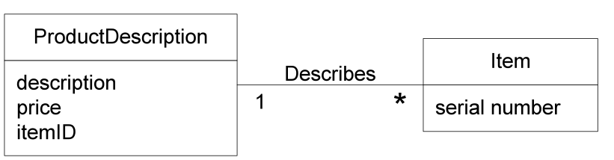
Description Classes
A description class contains information that describes something else
E.g. Item and ProductDescription

Slide 14
When to use Description Class
When information must be retained independent of existence of instances of the described item
When deleting the described item could result in information loss
When it reduces redundant information
Q4

Slide 15
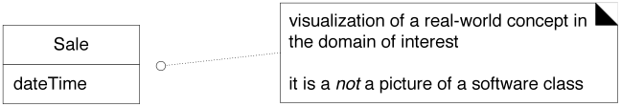
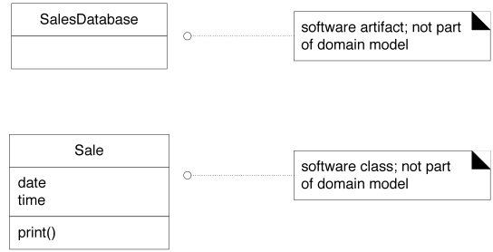
Avoid Premature Design
Good
Avoid
Avoid
Notes:
Mixing design elements with domain elements can clutter your domain model

Slide 16
Confusion with Databases
Domain model ≠ Data model
Data models:
  Only show persistent data
  Exclude classes that don’t have attributes
Domain models may include:
  External actors, transient data, any real-world classes
  Also classes without attributes/data that have a purely behavioral role
Q5
Notes:
Domain model can easily be extended to your data model (ER-Diagram) and your design model (class diagram)

Slide 17
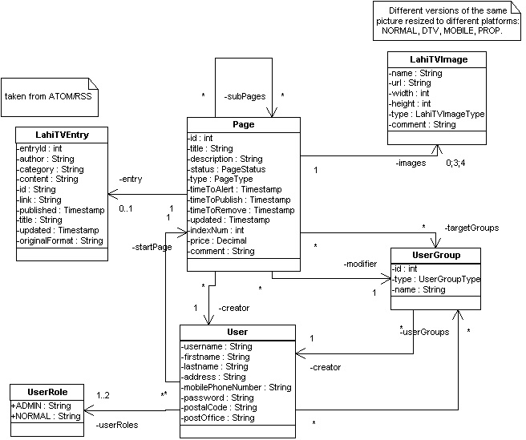
Don’t Have Too Much Details
Notes:
LahiTV domain model, from http://130.188.225.9:8080/lahitv/doc/integration_guide.html.
It’s a content management system.

Slide 18
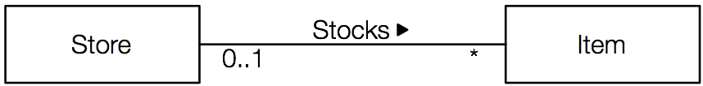
Association Notations
Association name:
Use verb phrase
Capitalize
Typically camel-case or hyphenated
Avoid “has”, “use”
Reading direction:
Can exclude if association reads left-to-right or top-to-bottom
Multiplicity (Cardinality):
‘*’ means “many”
x..y means from x to y inclusively

Slide 19
Cardinality (or Multiplicity)

Slide 20
More Association
Classes can have multiple associations
Classes can also self-associate!
  Object creates itself
  Object modifies itself
  Object moves itself…

Slide 21
Attributes
An object’s logical data value that must be remembered
  Some attributes are derived from other attributes
Usual primitive attributes (data types not shown in DM)
Common compound attributes
  Date, time, address, SSN, phone number, bar codes, etc.
  May even become full class objects in design…

Slide 22
Visibility in Domain Models
Notes:
The full UML attribute syntax:
visibility name : type multiplicity = default {property-string} => e.g. + store : Walmart [1..*] {readOnly}

Slide 23
POS Domain Model
Notes:
For your reference …

Slide 24
Next …
In-class Exercise
  Create domain model for your project based on use cases (2 rich ones) that you have developed for Milestone 2
  Present your model to the class
Notes:
We’ll do this in class!

